Slide 1
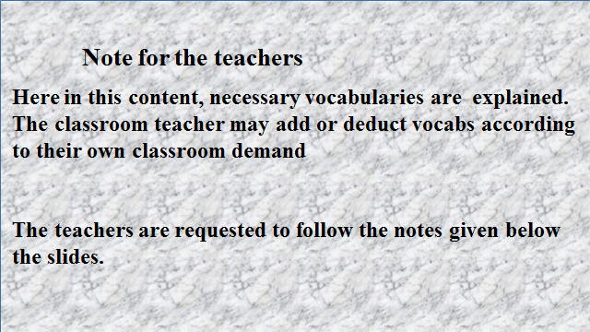

Slide 2
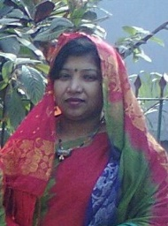
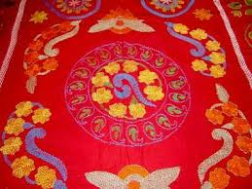
me
Ismat Ara Mamataz
Asst.Teacher( English)
Dhanmondi Govt. Boys’High School,
Dhaka
Notes:
In this slide this colourful nakshi pillow and the sari I am wearing, have been used so that the learners can be attentive to the class.If the learners ask him/her any question about the pictures, he/she will answer these are nakshi works in the pillow and in the sari.

Slide 3
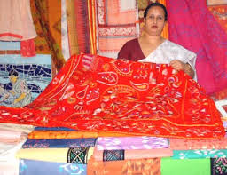
WELCOME
TO
MY ENGLISH 1st PAPER CLASS
Class viii
Notes:
In this slide this nakshi nakshi kanthas, have been used so that the learners can be introduced with the word “Nakshi”.If the learners ask him/her any question about the picture, he/she will answer these are nakshi works in the kanthas.

Slide 4
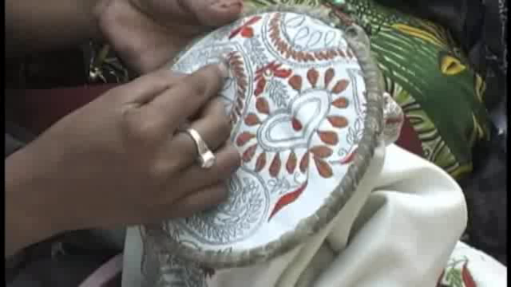
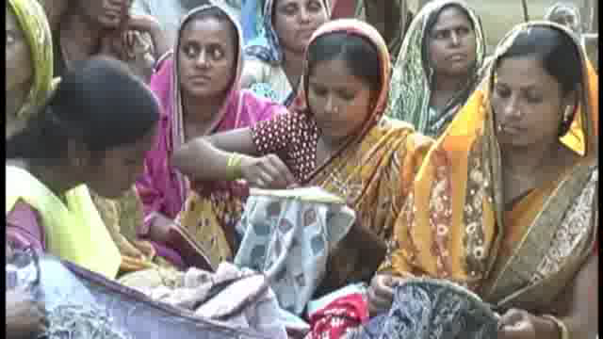
Let’s enjoy a video.
*What have you seen in the video?

Slide 5
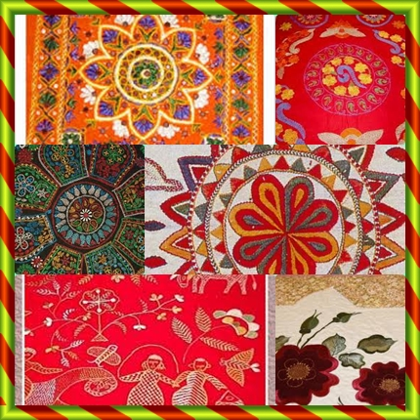
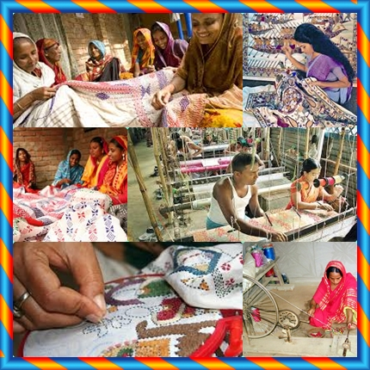
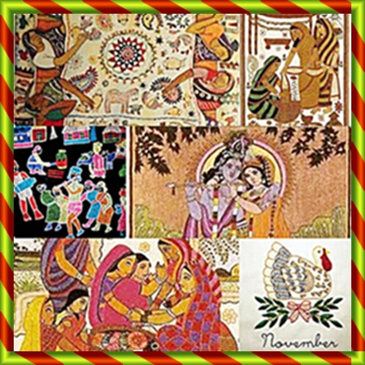
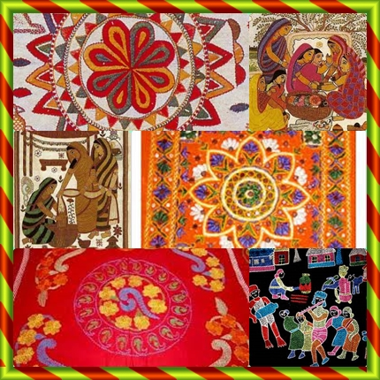
TODAY’S TOPIC
NAKSHI KANTHA
UNIT-6
Lesson-2

Slide 6
LEARNING
OUTCOMES
By the end of the lesson the learners will be able to
* ask and answer questions
*tell about Nakshi Kantha
*infer meaning from context
* write a paragraph
*fill in the blanks
*make questions

Slide 7
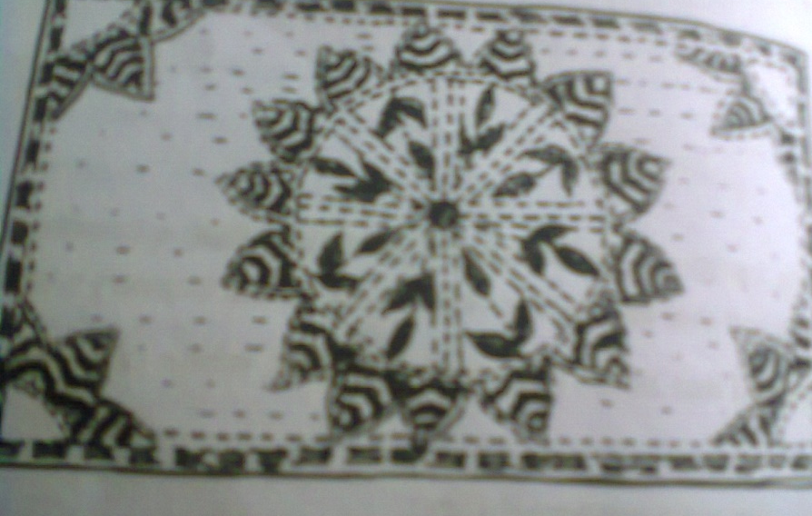
A . before TEXT READING:
pair work
Look at the picture and the questions. Then ask and answer the questions with your partner.
1. What do you see in the picture?
2. What is it called?
3. Have you seen it before? Where?
4. What do we do with it?

Slide 8
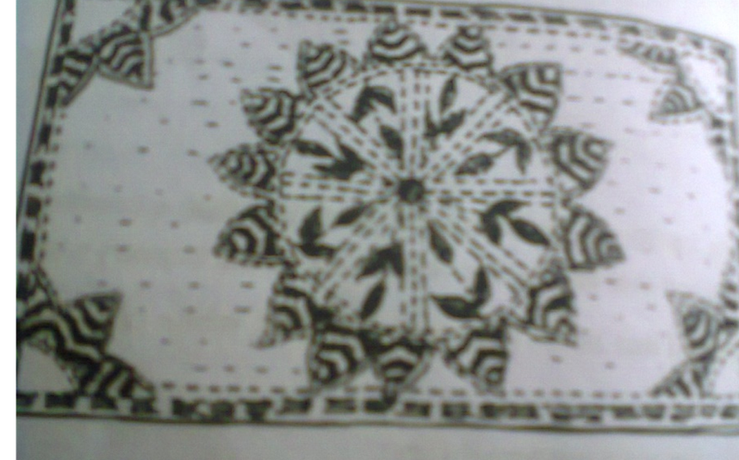
B. Text reading
Notes:
The learners will be asked to read the text to know about Nakshi kantha. The teacher will monitor keeping interaction with them. After they will have finished reading, he/she will facilitate them to explain the text and will assess them through continuous process using his/her own ways.

Slide 9
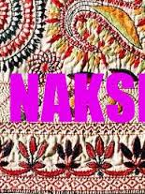
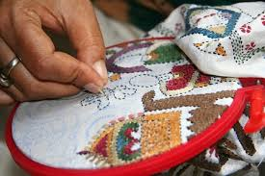
NAKSHI
(Noun)
NAKSHI
beautification;
colouring,
decoration,
embellishment,
ornamentation,
The woman is making ornamentation /nakshi on the kantha.

Slide 10
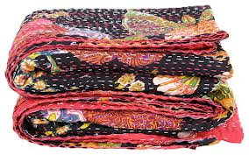
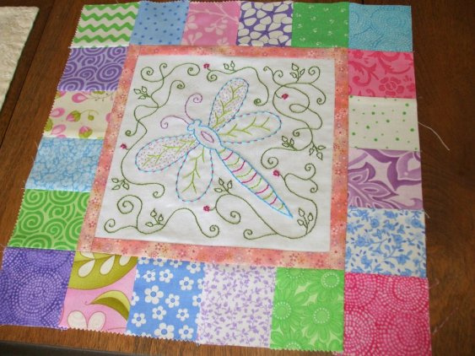
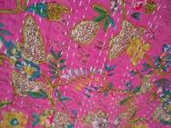
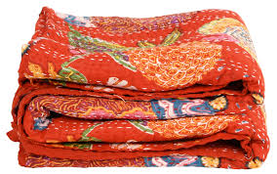
KANTHA(noun)
The word kantha has no discernible etymologY. The exact time of origin of the word kantha is not accurately known but it probably had a precursor in kheta (khet in Hindi and Bengali means "field"). According to Niaz Zaman, the word ‘kantha ‘originated from the Sanskrit word kontha, means rags, as kantha is made of rags (torn cloths).

Slide 11
Nakshi kantha
Notes:
The learners will be asked to describe what they know about Nakshi Kantha.2-3 learners can be invited in front of the audience to tell about naksh katha.

Slide 12
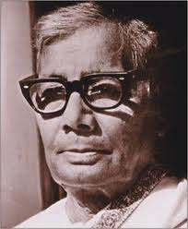
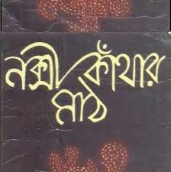
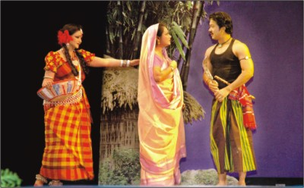
Nakshi Kanthar Math
Jasim Uddin
Notes:
Showing the pictures to the learners can be asked what they know about Nakshi Kanthar Math. 2-3 students can be invited in front of the audience so that they can overcome their shyness of speaking. After that the video on Nakshi Kanthar Math may be displayed.

Slide 13
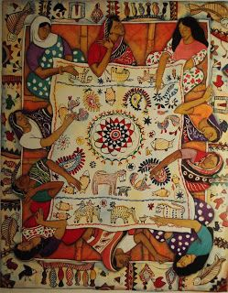
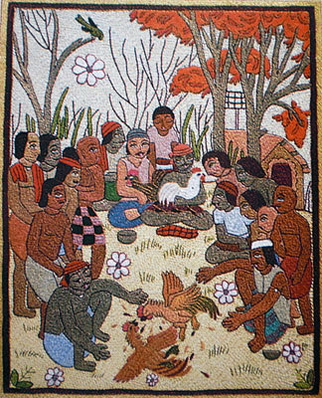
Artistic(adj)
performed, made, or arranged decoratively and tastefully,
stylish
Notes:
The learners can beasked for making sentences.

Slide 14
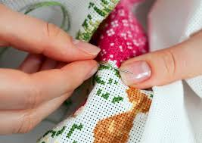
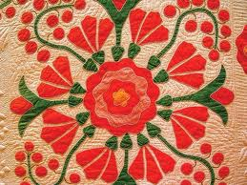

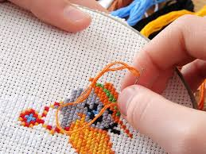
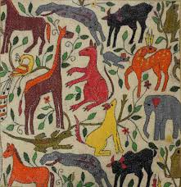
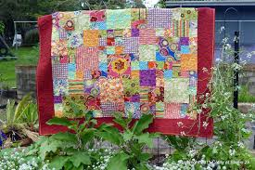
Embroidered Quilt
Embroidery
the art or process of working ornamental designs upon cloth or other material with a needle and thread.
a quilt containing embroidery.
Notes:
The learners will be invited for making sentences.

Slide 15
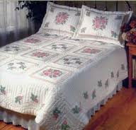
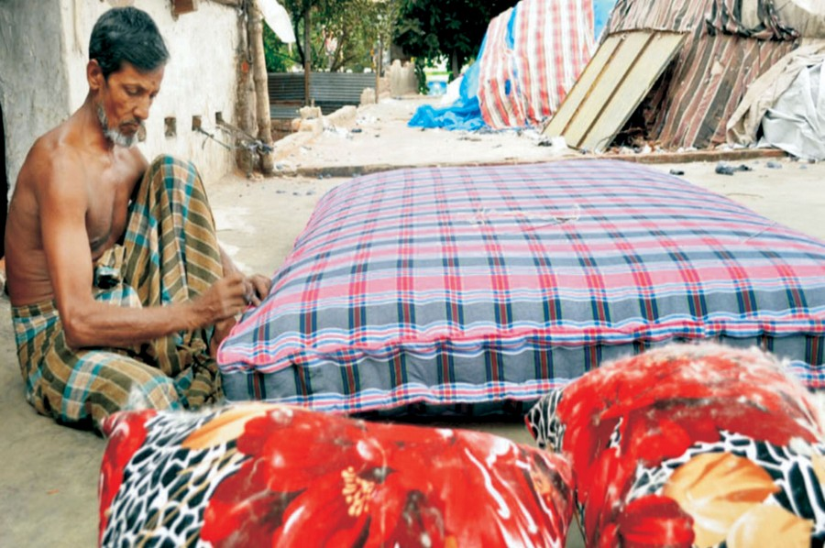
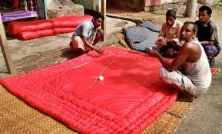
Quilt
1 a thick warm cover for a bed, consisting of a soft filling sewn between two layers of material, usually with crisscross seams
2 a bedspread or counterpane
a coverlet for a bed, made of two layers of fabric with some soft substance, as wool or down, between them and stitched in patterns or tufted through all ...
Notes:
The learners will be invited for making sentences.

Slide 16
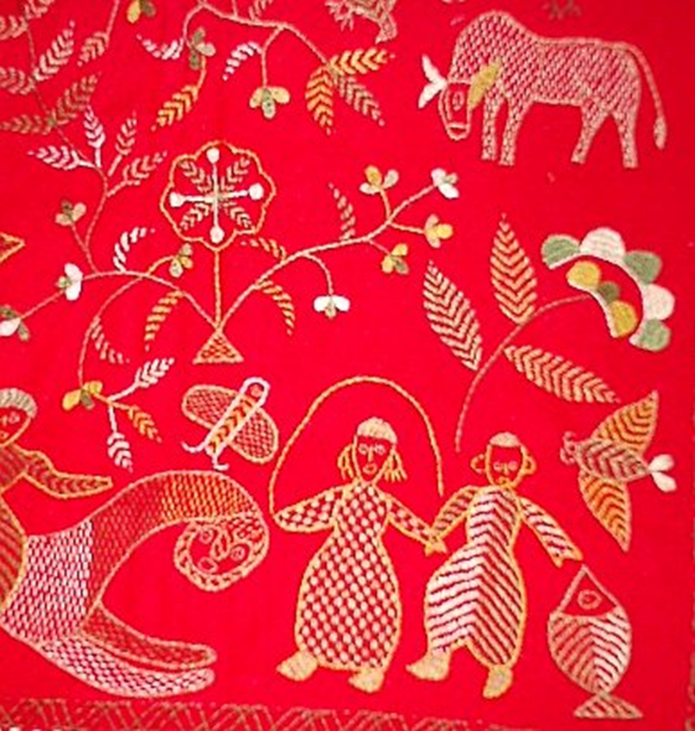
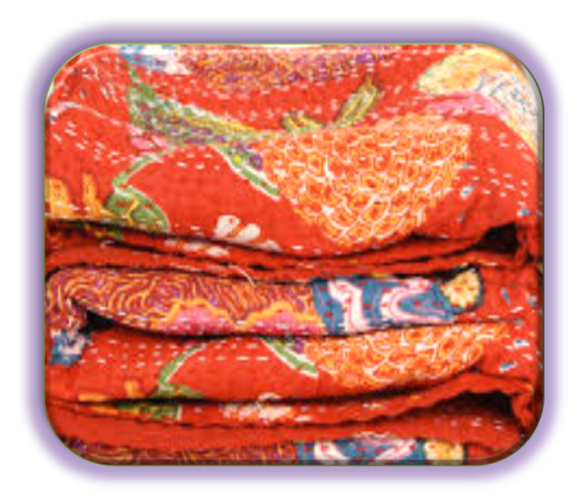
TRADITIONAL
age old , long established
Nakshi kantha is a
traditional craft.
Notes:
The learners will be invited for making sentences.

Slide 17
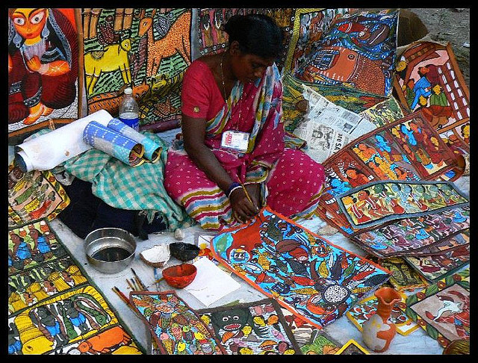
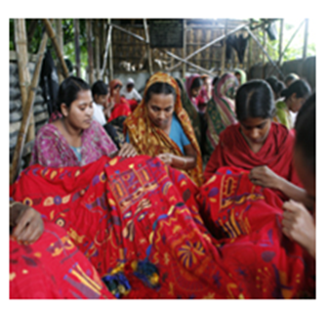
Design
the combination of details or features of a picture, building, etc.; the pattern or motif of artistic work:
Notes:
The learners will be invited for making sentences. the given sentence may be shown later on.

Slide 18
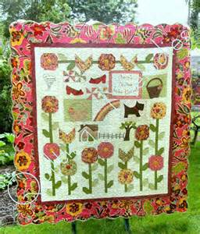
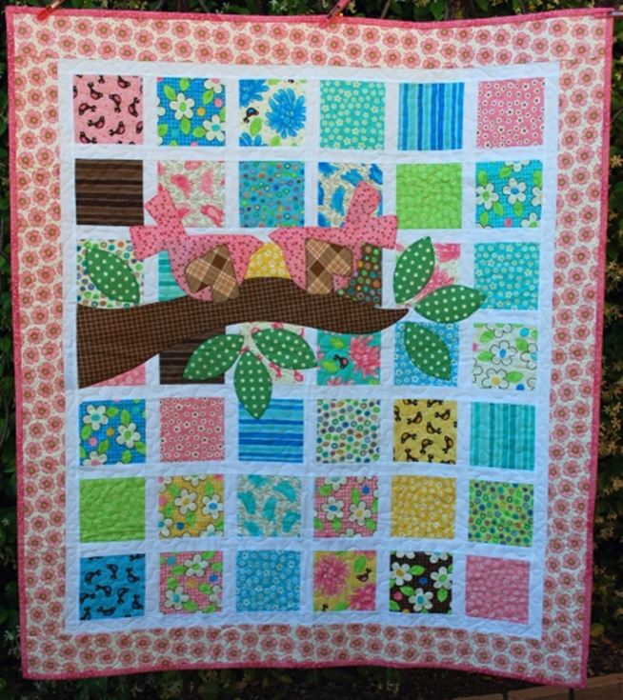
PATTERN
anything fashioned or designed to serve as a model for something to be made
The pattern of our nakshi kantha is very praiseworthy.
Notes:
The learners will be invited for making sentences. the given sentence may be shown later on.

Slide 19


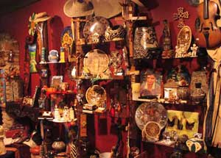
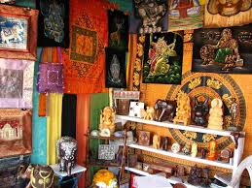
arts and craft store
Notes:
The learners will be asked for making sentences.

Slide 20
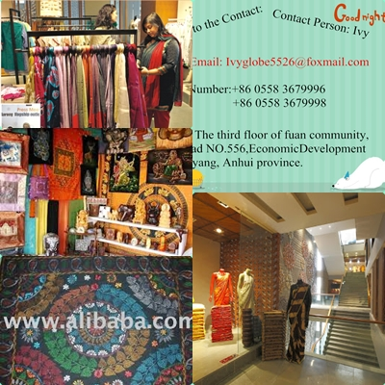

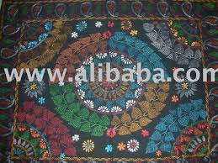
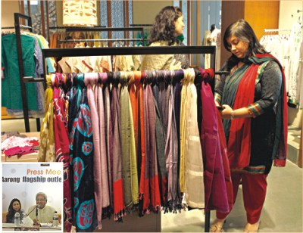
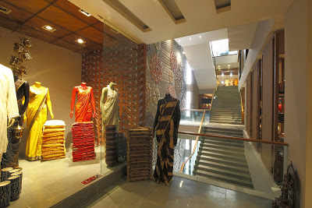
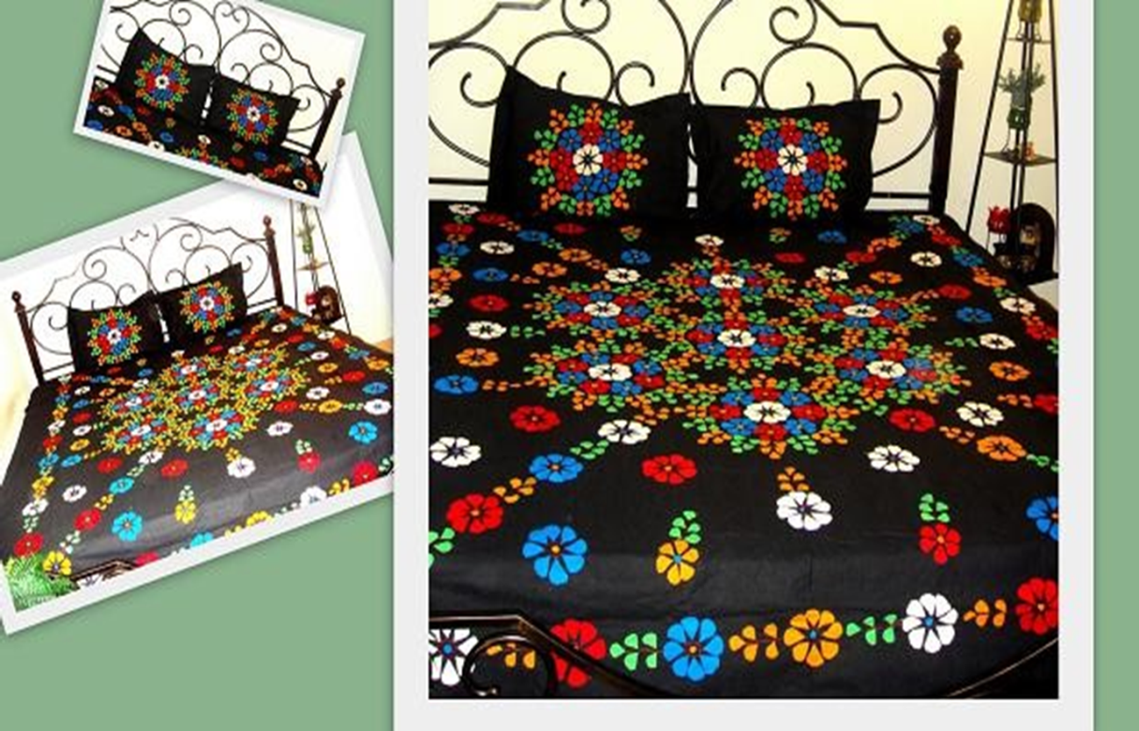
Commercially
For the purpose of business.
Notes:
The learners will be asked to infer the meaning of the word. The teacher may show the meaning later on.

Slide 21
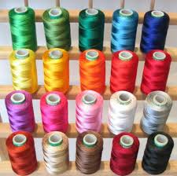
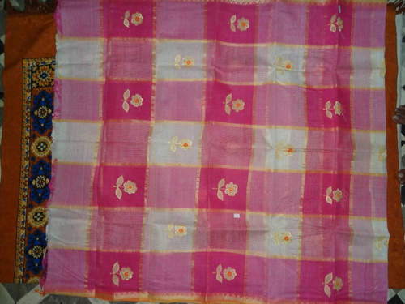
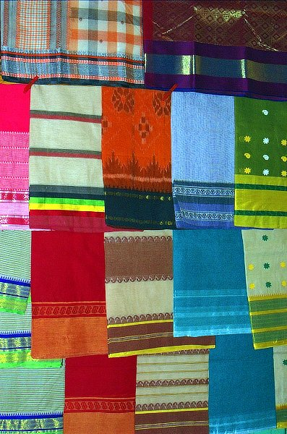
C . Write a paragraph about how a nakshi kantha is made. Start like this- Old or new cloth and coloured thread is needed to make a nakshi kantha. First the cloth is folded. Then……
Notes:
The learners will be asked to follow the instruction given in the text.

Slide 22
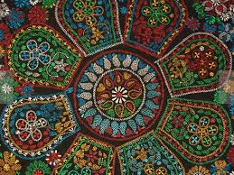
D. Do you like a nakshi kantha or an ordinary kantha,? Why?
B- ?
A- ?
Notes:
The learners will be asked to write 5 sentences for the reasons. Showing the picture the teacher can ask the learners to identify the types of the kantha. Or also speaking skill can be performed.

Slide 23
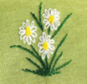

E. Complete the sentences with given clues
*Board work:-
Bengali,
patterns,
embroidery,
years,
fashion,
art,
rural,
designs,
quilt,
pattern
noksha
1.Nakshi kantha means artistic ---------------
2.The name was taken from a -------------------- word ---------------.
3.The art has been practised in ------------------------- Bengal for _____________.
4.Nakshi kanthas are now sold in ------------------------------ shops.
5.Nakshi kanthas now in great demand because of their colourful --------------------------- and ---------------.
6. Nakshi kathas are a kind of---------------
***Note :Multiple choice questions also can be made with these statements.
Notes:
Multiple choice questions also can be made with these statements.

Slide 24
F. WORK IN GROUPS: Make 5 questions for the completed statements in ‘E’ above.One is done for you.
*1.What does naksha mean?
Check your answers:
2.Where was the name taken from?
3.How long has the art been practised? Where?
4.Where now are nakshi kantha sold in?
5.Why are nakshi kanthas in great demand?
6.What are nakshi kanthas?
Structure of making wh questions
Wh+ auxiliary verb+ s+ main verb + extension + ? (note of interrogation)
Notes:
The structure of making ‘wh-questions’ may be given on the board and the learners may be asked for practicing of making questions individually.

Slide 25

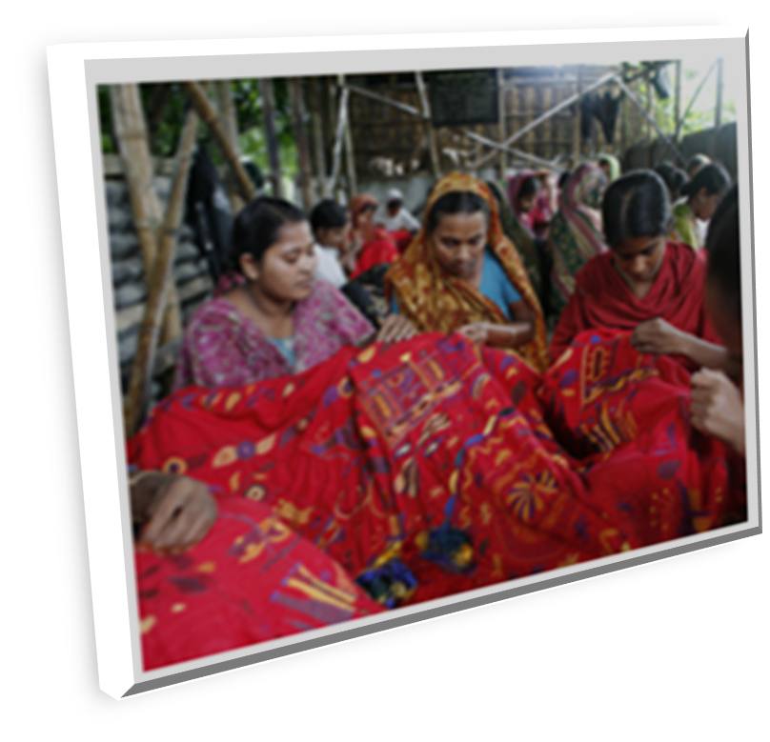

Home work
Write the summary of the passage/text in 1/4th (30 words) of total words of it.
Notes:
The teacher can give some instructions how to write a summery.

Slide 26


THANK YOU SO MUCH
Notes:
In this slide these nakshi works have been used so that the learners can be able to make clear themselves about the word “nakshi’ in this lesson Nakshi Kantha” they have read . If the learners ask the teacher any question about the pictures, he/she will answer these are nakshi works in the kanthas, sari and the backgroud.

Slide 27
Acknowledgement
MoE, DSHE, NCTB & A2I respective officials
And the editors panel:
Mr. Ranjit Poddar, Associate Prof, TTC, Dhaka,
Mr. Md. Jahangir Hasan, Asst. Prof, TTC, Rangpur,
Urmila Khaled Asst. Prof, TTC, Dhaka.
Their direction, valuable suggestions and intensive supervision have enriched the model contents.

